Slide 1
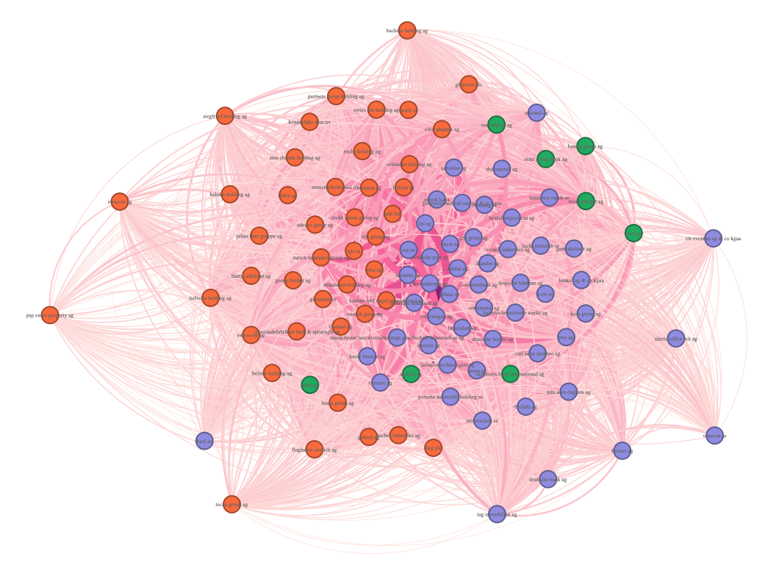
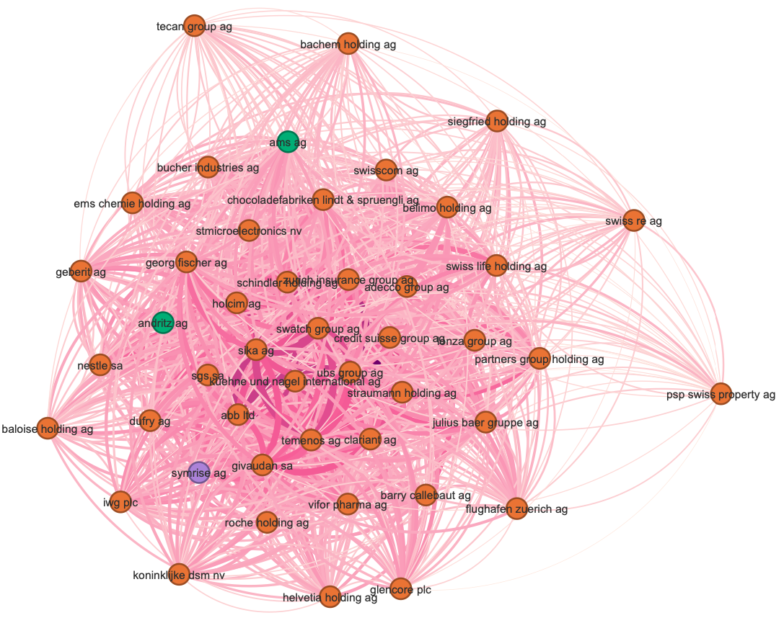
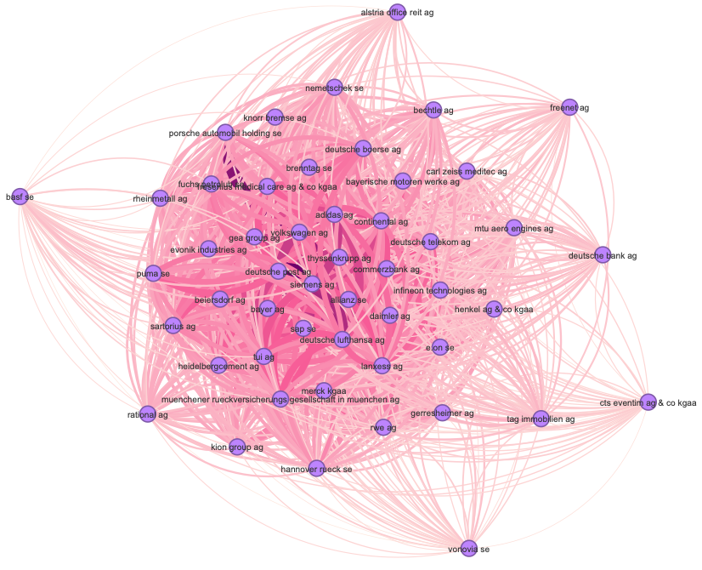
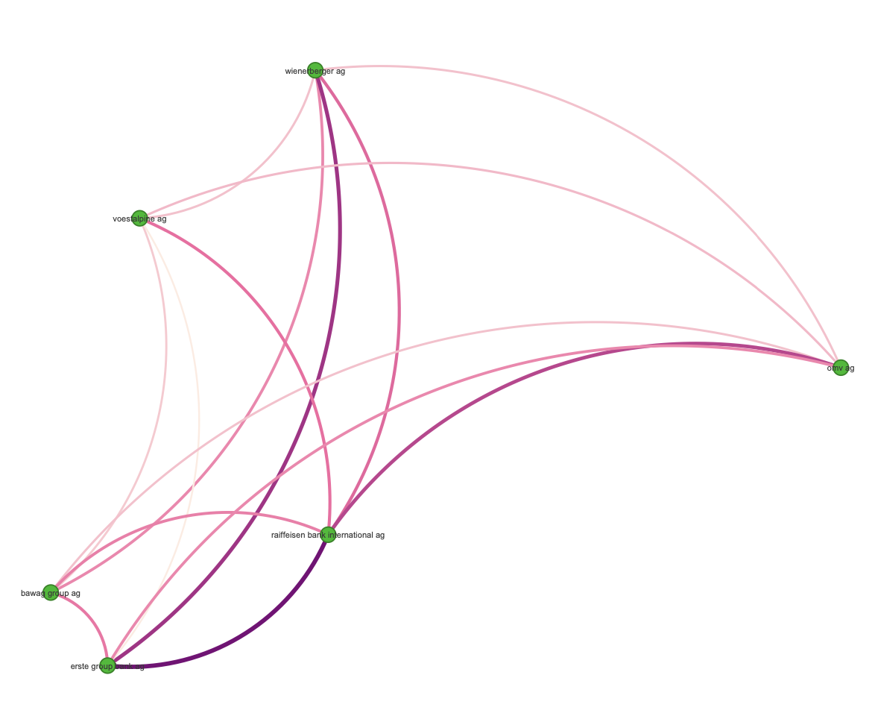
Network 2011
Original Network 2011
Cluster 1
Cluster 2
Cluster 3

Slide 2
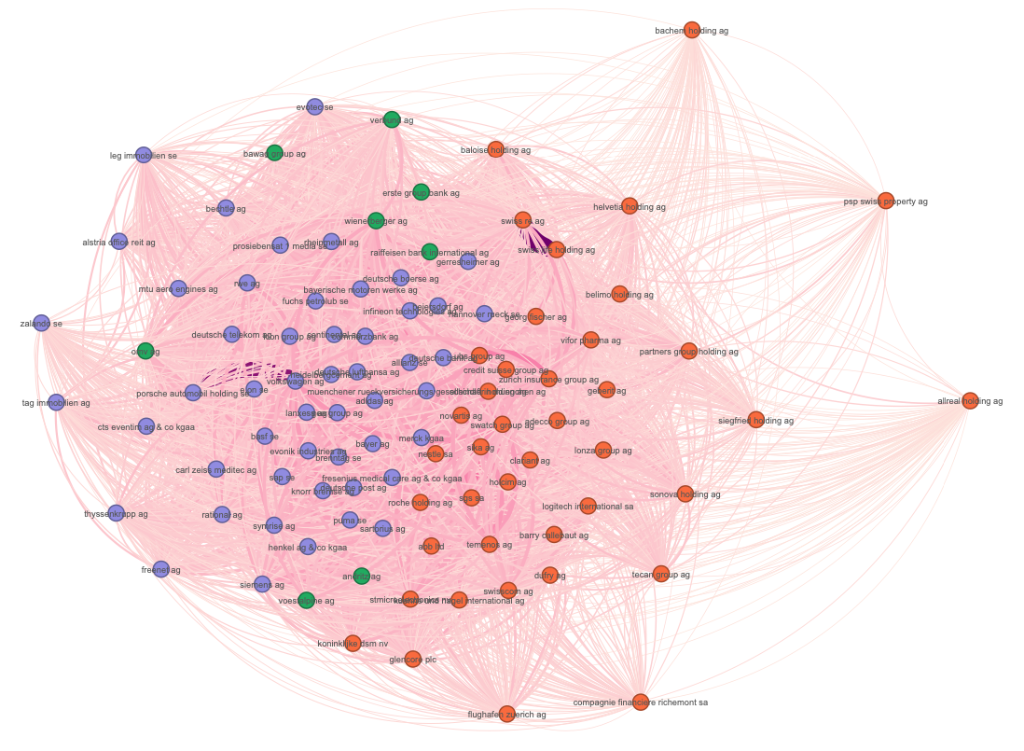
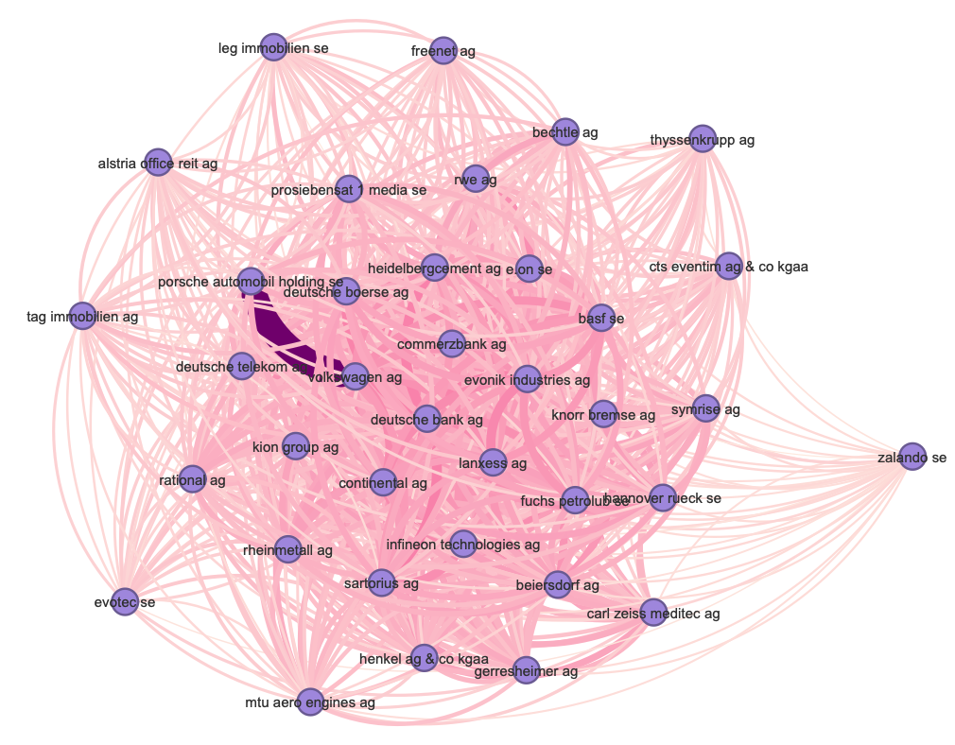
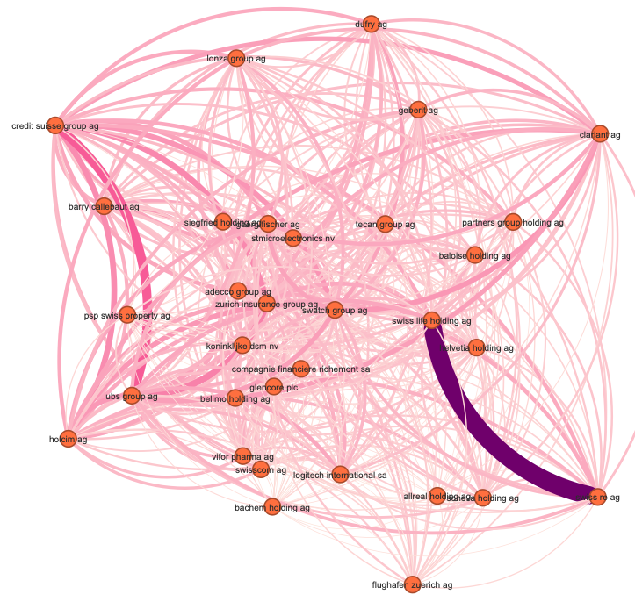
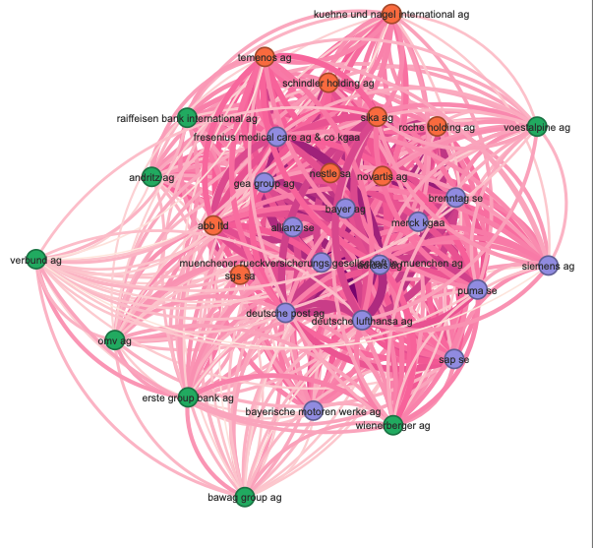
Network 2013
Original Network 2013
Cluster 1
Cluster 2
Cluster 3

Slide 3
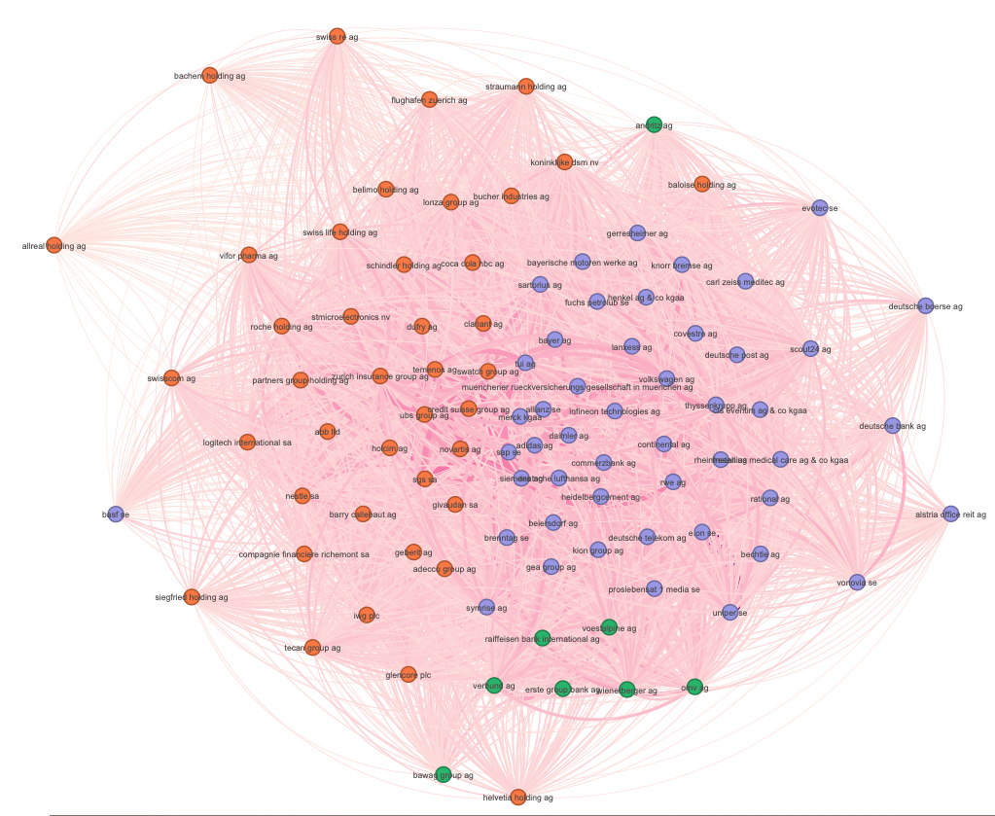
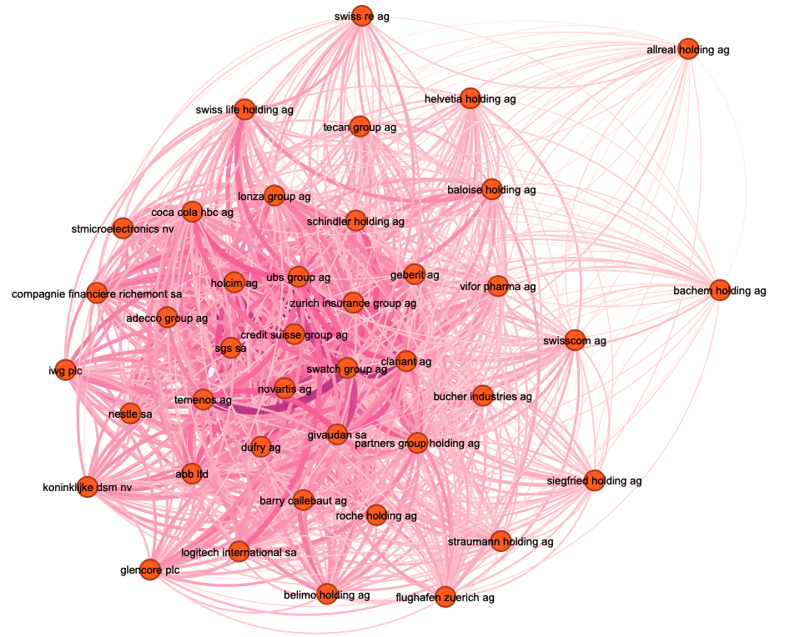
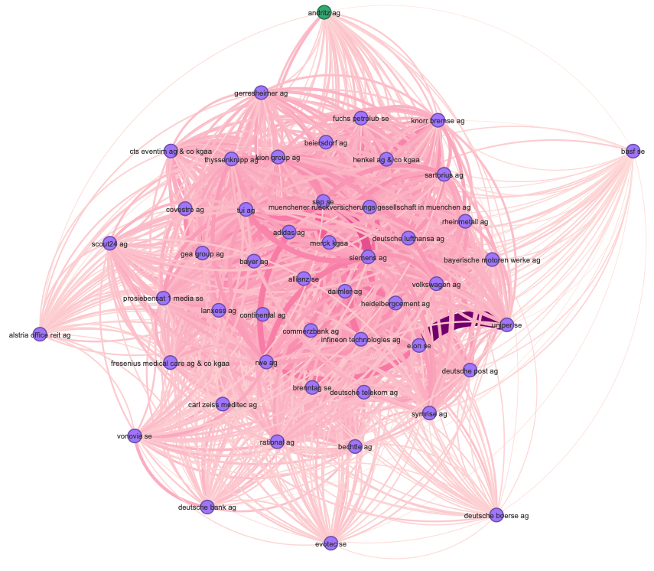
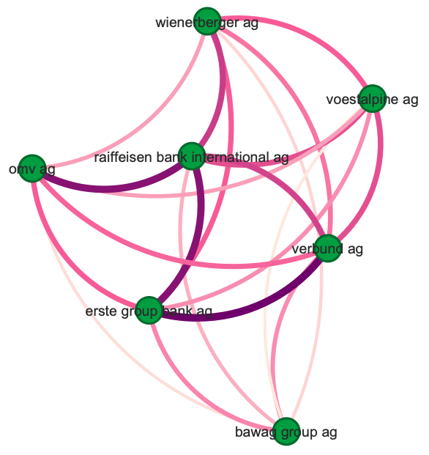
Network 2016
Original Network 2016
Cluster 1
Cluster 2
Cluster 3

Slide 4
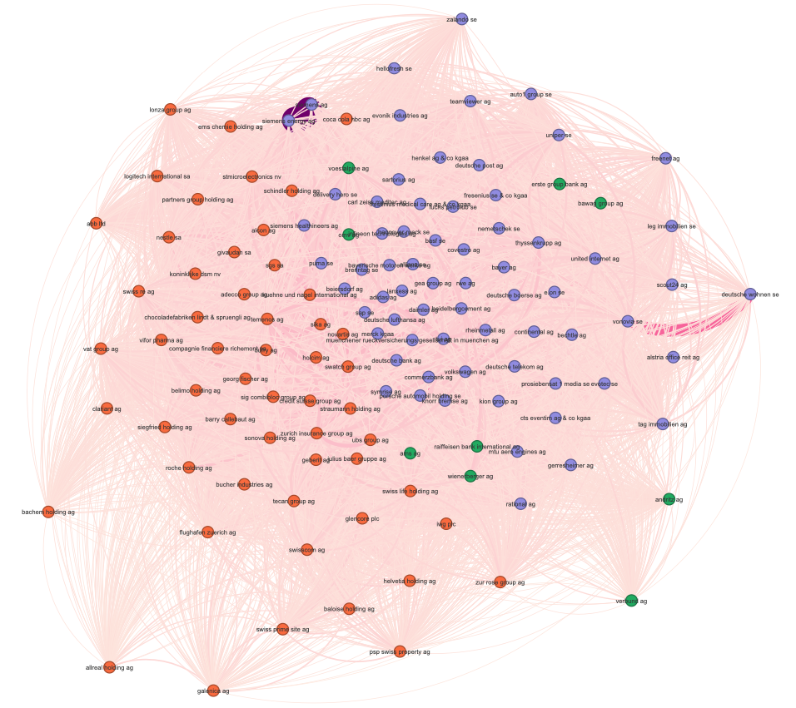
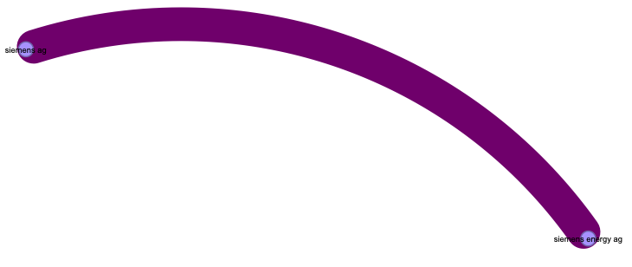
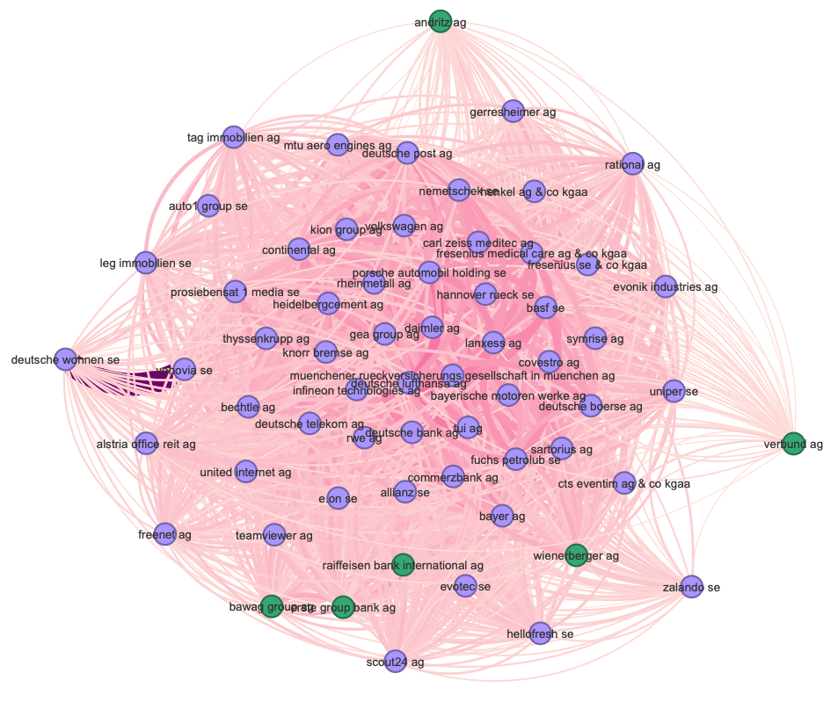
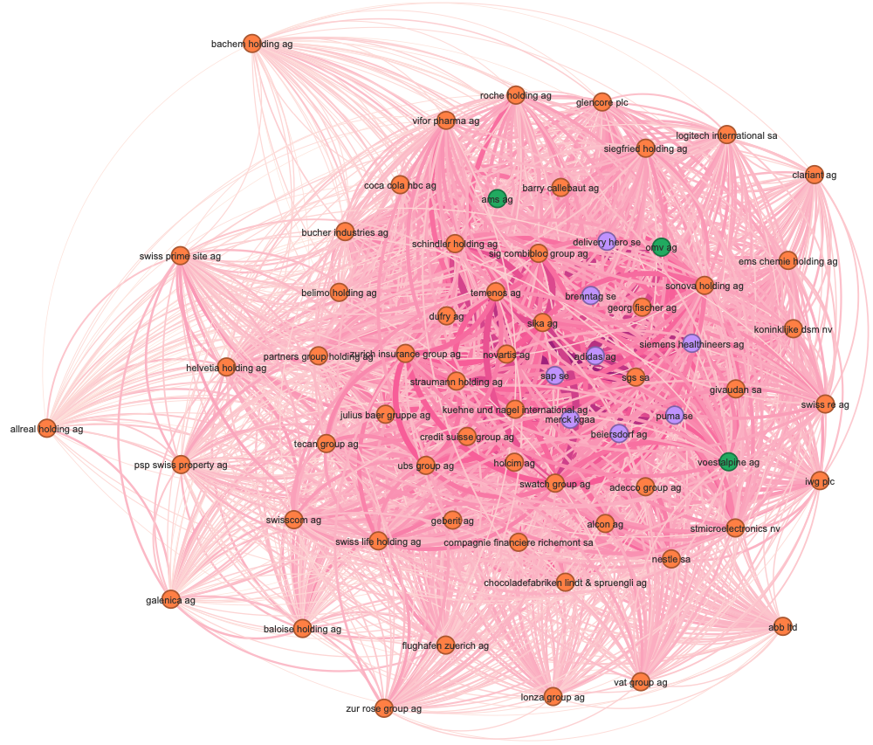
Network 2022
Original Network 2022
Cluster 1
Cluster 2
Cluster 3

Slide 5
Cluster Statistics
2011
Germany
Switzerland
Austria
93%
100%
100%
50%
42%
8%
4%
2%
0%
0%
0%
0%
Origninal Network
Cluster 1
Cluster 2
Cluster 3
2013
100%
100%
51%
41%
45%
29%
26%
8%
0%
0%
0%
0%
Origninal Network
Cluster 1
Cluster 2
Cluster 3
2016
100%
98%
100%
49%
42%
8%
0%
0%
0%
2%
0%
0%
Origninal Network
Cluster 1
Cluster 2
Cluster 3
2022
100%
90%
83%
51%
42%
7%
0%
0%
10%
0%
12%
5%
Origninal Network
Cluster 1
Cluster 2
Cluster 3

